Slide 1
Introduction to Artificial Intelligence
(Symbolic AI)
Siphokazi Tswane

Slide 2
Introduction to AI
AI Definition
Related Fields
History of AI
AI Philosophy
Applications of AI (Planning, understanding, natural language processing, parallel and distributed AI, learning, connectionist model, robotics, expert systems, fuzzy logic, artificial neural networks)

Slide 3
Genetic Algorithms (GA)
Living systems solve problems by evolving new creatures.
Mating produces millions of variations.
The variations that are most successful survive to become the parents of the next generation.
Work in a similar way to natural evolution.
The thing that you want to evolve is encoded as a gene.
The gene is used to produce ‘organisms’.
The fitness of the organisms is evaluated on the specified task.
The best organisms are ‘mated’ by randomly combining their genes to produce new organisms.
The process is repeated until the problem is solved.
Notes:
A genetic algorithm is a heuristic search method used in artificial intelligence and computing.
A heuristic is a mental shortcut that allows people to solve problems and make judgments quickly and efficiently. These rule-of-thumb strategies shorten decision-making time and allow people to function without constantly stopping to think about their next course of action.
A genetic algorithm is used for finding optimized solutions to search problems based on the theory of natural selection and evolutionary biology. Genetic algorithms are excellent for searching through large and complex data sets.

Slide 4
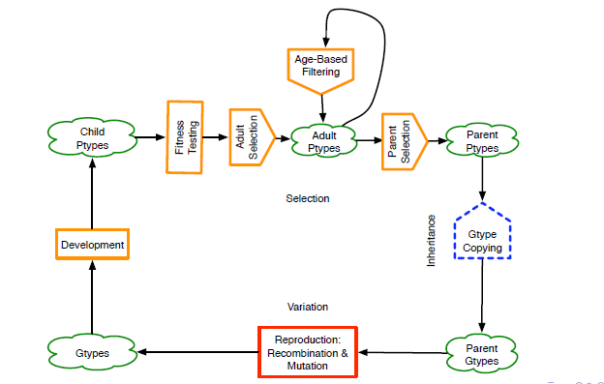
The GA Process
Slide credit: Keith Downing, Evolving Artificial Intelligence, NTNU

Slide 5
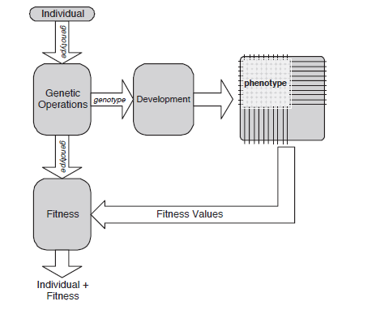
Artificial Development

Slide 6
Applications of Genetic Algorithms
Evolving controllers.
Optimizing algorithms, production processes, etc. where you have a large number of parameters.
Can be used to design products, such as semiconductors and turbines.
Used in genetic programming where a program is evolved for a particular function.
Bioninformatics
Task/job scheduling
More: http://brainz.org/15-real-world-applications-genetic-algorithms/
https://en.wikipedia.org/wiki/List_of_genetic_algorithm_applications
Notes:
Bio informatics is a science field that is similar to but distinct from biological computation, while it is often considered synonymous to computational biology. Biological computation uses bioengineering and biology to build biological computers, whereas bioinformatics uses computation to better understand biology

Slide 7
Artificial Neural Networks (ANN)
Loosely inspired by the brain.
Number of neurons connected to each other.
Each connection has a particular weight.
Activity in one neuron is passed to the connected neurons.
Variety of types and network architectures.
Notes:
An artificial neural network (ANN) is the piece of a computing system information processing model that is inspired by the way biological nervous systems, such as the brain designed to simulate the way the human brain analyzes and processes information.
An artificial neural network uses COMPUTATIONAL NODES in an attempt to simulate the network neurons that make up a human brain so that the computer will be able to learn things and make decisions in a humanlike manner. ANNs are created by programming regular computers to behave as though they are interconnected brain cells.
ANN is the foundation of artificial intelligence (AI) and solves problems that would prove impossible or difficult by human or statistical standards.
It helps you to build predictive models from large databases. This model builds upon the human nervous system. It helps you to conduct image understanding, human learning, computer speech, etc.

Slide 8
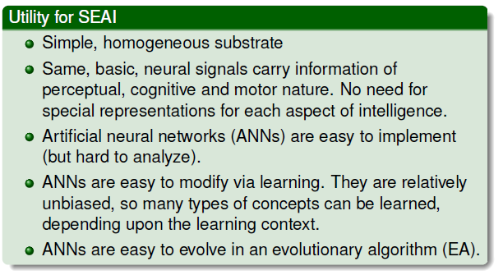
ANN (cont.)
Slide credit: Keith Downing, Darwin in the Machine: Evolving Neural Networks for Artificial Intelligence, NTNU

Slide 9
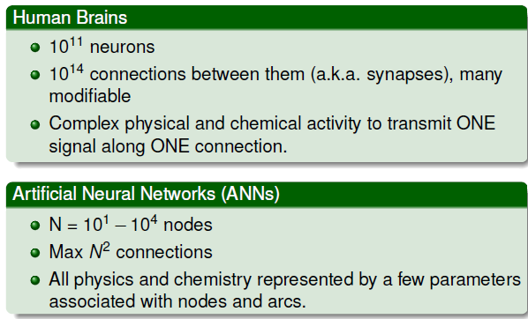
ANN ABSTRACTION
Slide credit: Keith Downing, Darwin in the Machine: Evolving Neural Networks for Artificial Intelligence, NTNU
Notes:
Processing elements (also known as either a neurode or perceptron) are connected to other processing elements. Typically the neurodes are arranged in a layer or vector, with the output of one layer serving as the input to the next layer and possibly other layers. A neurode may be connected to all or a subset of the neurodes in the subsequent layer, with these connections simulating the synaptic connections of the brain. Weighted data signals entering a neurode simulate the electrical excitation of a nerve cell and consequently the transference of information within the network or brain. The input values to a processing element, i_{n}, are multiplied by a connection weight, w_{n,m}, that simulates the strengthening of neural pathways in the brain. It is through the adjustment of the connection strengths or weights that learning is emulated in ANNs.

Slide 10
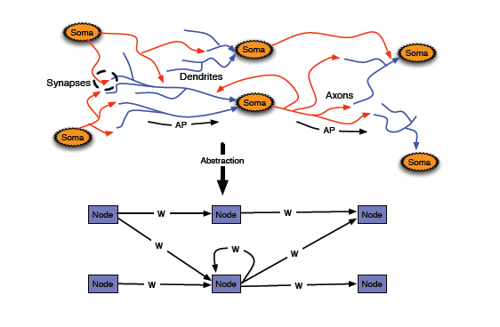
ANN Structural Abstraction
Slide credit: Keith Downing, Darwin in the Machine: Evolving Neural Networks for Artificial Intelligence, NTNU
Notes:
ANN has processing elements (also known as either a neurode or perceptron) are connected to other processing elements. Typically the neurodes are arranged in a layer or vector, with the output of one layer serving as the input to the next layer and possibly other layers. A neurode may be connected to all or a subset of the neurodes in the subsequent layer, with these connections simulating the synaptic connections of the brain. Weighted data signals entering a neurode simulate the electrical excitation of a nerve cell and consequently the transference of information within the network or brain. The input values to a processing element, i_{n}, are multiplied by a connection weight, w_{n,m}, that simulates the strengthening of neural pathways in the brain. It is through the adjustment of the connection strengths or weights that learning is emulated in ANNs.

Slide 11
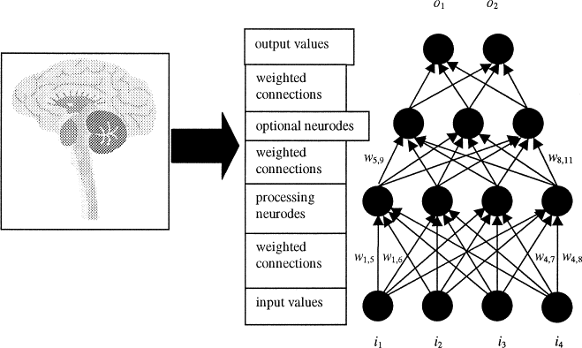
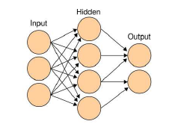
ANN Training
A network is trained by exposing it to the training data and adjusting the weights so that its output is correct.
After enough examples, the network can be used to classify new data.
Good way of learning complex nonlinear functions.
Slide credit: David Garmez, Artificial Intelligence Opening Lecture
Notes:
A neural network is a group of connected I/O units where each connection has a weight associated with its computer programs.

Slide 12
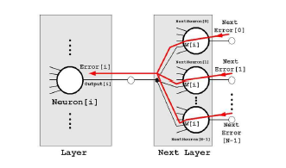
ANN Traning with Backpropagation
Slide credit: David Garmez, Artificial Intelligence Opening Lecture
Notes:
Back-propagation is the essence of neural net training. It is the method of fine-tuning the weights of a neural net based on the error rate obtained in the previous epoch (i.e., iteration). Proper tuning of the weights allows you to reduce error rates and to make the model reliable by increasing .
Backpropagation is a short form for "backward propagation of errors." It is a standard method of training artificial neural networks. This method helps to calculate the gradient of a loss function with respects to all the weights in the network. generalization

Slide 13
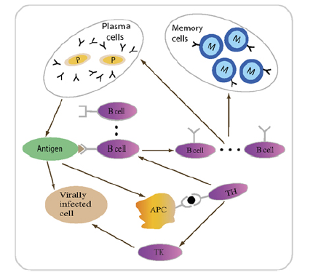
Artificial Immune Systems (AIS)
AIS are a class of computationally intelligent systems inspired by the principles and processes of the vertebrate immune system.
The algorithms typically exploit the immune system's characteristics of learning and memory to solve a problem.
Notes:
The field of Artificial Immune Systems (AIS) is concerned with abstracting the structure and function of the immune system to computational systems, and investigating the application of these systems towards solving computational problems from mathematics, engineering, and information technology. AIS is a sub-field of Biologically-inspired computing, and Natural computation, with interests in Machine Learning and belonging to the broader field of Artificial Intelligence.
Artificial Immune Systems (AIS) are adaptive systems, inspired by theoretical immunology and observed immune functions, principles and models, which are applied to problem solving.^{[1]}
AIS is distinct from computational immunology and theoretical biology that are concerned with simulating immunology using computational and mathematical models towards better understanding the immune system, although such models initiated the field of AIS and continue to provide a fertile ground for inspiration. Finally, the field of AIS is not concerned with the investigation of the immune system as a substrate for computation, unlike other fields such as DNA computing.

Slide 14
Application of AIS
Pattern recognition;
Fault and anomaly detection;
Data analysis;
Data mining (classification/clustering)
Agent-based systems;
Scheduling;
Machine-learning;
Autonomous navigation and control;
Search and optimization methods;
Artificial life;
Security of information systems;
Optimization;
Just to name a few

Slide 15
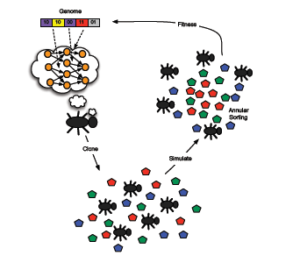
Swarm intelligence (SI)
Swarm intelligence (SI) is the collective behaviour of decentralized, self-organized systems, natural or artificial. It an attempt to emulate the collective intelligent behaviour of some known biological ecosystems. Natural examples of SI include ant colonies, bird flocking, animal herding, bacterial growth, and fish schooling.
Notes:
Swarm intelligence (SI) is the collective behavior of decentralized, self-organized systems, natural or artificial. The concept is employed in work on artificial intelligence. The expression was introduced by Gerardo Beni and Jing Wang in 1989, in the context of cellular robotic systems.^{[1]}
SI systems consist typically of a population of simple agents or boids interacting locally with one another and with their environment. The inspiration often comes from nature, especially biological systems. The agents follow very simple rules, and although there is no centralized control structure dictating how individual agents should behave, local, and to a certain degree random, interactions between such agents lead to the emergence of "intelligent" global behavior, unknown to the individual agents. Examples of swarm intelligence in natural systems include ant colonies, bird flocking, hawks hunting, animal herding, bacterial growth, fish schooling and microbial intelligence.
The application of swarm principles to robots is called swarm robotics, while 'swarm intelligence' refers to the more general set of algorithms. 'Swarm prediction' has been used in the context of forecasting problems. Similar approaches to those proposed for swarm robotics are considered for genetically modified organisms in synthetic collective intelligence. ^{[2]}

Slide 16
Ants Colony Algorithm
Real ants wander randomly. When they find food they return to their colony while laying down pheromone trails.
If other ants find such a path, they are likely to follow the trail, returning and reinforcing it if they find food.
Over time the pheromone trail starts to evaporate, thus reducing its attractive strength.
The more time it takes for an ant to travel down the path and back again, the more time the pheromones have to evaporate.
Notes:
In computer science and operations research, the ant colony optimization algorithm (ACO) is a probabilistic technique for solving computational problems which can be reduced to finding good paths through graphs. Artificial Ants stand for multi-agent methods inspired by the behavior of real ants. The pheromone-based communication of biological ants is often the predominant paradigm used.^{[2]} Combinations of Artificial Ants and local search algorithms have become a method of choice for numerous optimization tasks involving some sort of graph, e.g., vehicle routing and internet routing.
An ant colony is like a factory. Nestmates work together to convert resources (food) into products (more ants). ... Younger ants work inside the nest, taking care of the queen and her brood. Older workers go outside to gather food and defend the nest against enemies

Slide 17
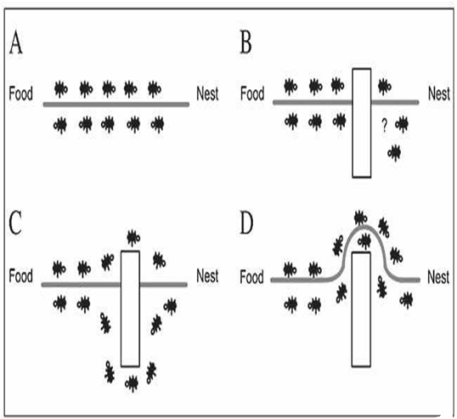
Ant Colony – cont’d
A short path gets marched over faster, and thus the pheromone density remains high as it is laid on the path as fast as it can evaporate.
Thus, when one ant finds a good (i.e. short) path from the colony to a food source, other ants are more likely to follow that path, and positive feedback eventually leads to all the ants following a single path.
The idea of the ant colony algorithm is to mimic this behaviour with "simulated ants" walking around a model of the problem to be solved.
Slide credit: David Garmez, Artificial Intelligence Opening Lecture

Slide 18
Applications of Ant Colony Algorithm
Finding the shortest path through a network.
Gene analysis.
Data clustering
Extend the model by having ants carry pieces of data.
Ant is programmed with a rule that makes it likely to drop data by similar pieces of data.
Clusters are built up by the random movements of the ants.

Slide 19
Homework
What are the differences between Artificial Intelligent systems and Artificial Life systems ?

Slide 20
Machine Learning (ML)
Application of AI techniques to identify patterns and classify data.
Learning is applied in a very restricted way to solve one particular problem – no aspiration towards human-level intelligence.
Uses a variety of AI techniques, such as neural networks, genetic algorithms, etc.
ML Applications
Identification of anomalous patterns of behaviour in security cameras.
Data mining.
Medical diagnosis.
Face recognition
Natural language processing. etc.
Notes:
Machine learning is an application of artificial intelligence (AI) that provides systems the ability to automatically learn and improve from experience without being explicitly programmed. Machine learning focuses on the development of computer programs that can access data and use it to learn for themselves.
The process of learning begins with observations or data, such as examples, direct experience, or instruction, in order to look for patterns in data and make better decisions in the future based on the examples that we provide. The primary aim is to allow the computers learn automatically without human intervention or assistance and adjust actions accordingly.
But, using the classic algorithms of machine learning, text is considered as a sequence of keywords; instead, an approach based on semantic analysis mimics the human ability to understand the meaning of a text.

Slide 21
AI Techniques
An AI technique is a method that exploits knowledge in solving a problem.
Nature of Knowledge
It is voluminous
It is hard to characterize accurately
It is constantly changing
It differs from data by being organized in a way that corresponds to the way it will be used.
Questions
Are there techniques that are appropriate for the solution of a variety of AI problems?
Can these techniques be useful in solving other problems?

Slide 22
AI Techniques –Cont’d
An AI technique must exploit knowledge in such a way that:
The knowledge captures generalization
It can be understood by people who must provide it
It can easily be modified to correct errors and reflect changes in the world and in our world view
It can be used in a great many situations even it is not totally accurate or complete
It can be used to help overcome its own sheer bulk by helping to narrow the range of possibilities that must be considered.
Note: that it is possible to solve AI problems using non-AI techniques (although the solution are not likely to be very good). It is also possible to apply AI techniques to the solution of non-AI problems

Slide 23
Characteristics of AI Techniques
Search – provides a way of solving important problems for which no more direct approach is available as well as a framework into which any direct techniques that are available can be embedded
Use of Knowledge – Provides a way of solving complex problems by exploiting the structures of the objects that are involved.
Abstraction – Provides a way of separating important features and variations from the many unimportant ones that would otherwise overwhelm any process.

Slide 24
How do we measure system’s Intelligence?
Turing Test (Alan Turing, 1950)
A method to determine whether a system can think
Used as criteria for evaluating success of AI system
Inquisitor, AI System, Human Inquisitor connected to AI System and Human by “wire” and free to ask either any question
If Inquisitor can not determine which is the Human without guessing then AI System is successful
Notes:
In the Turing test, an examiner sits behind a divider, and types questions to an unobserved entity. The entity (either a computer or a human) responds in text as if it was a human. If the examiner cannot distinguish a human response from a computer responding like a human, the computer passes the Turing test.

Slide 25
References
1. J. Russell and Peter Norvig (2003): Artificial Intelligence – A Modern Approach, Stuart, Prentice Hall.
2.Elaine Rich and Kevin Knight, Artificial Intelligence (1991), McGraw-Hill Inc. (Second Edition)
3. Artificial Intelligence and Expert Systems for Engineers; C.S. Krishnamoorthy; S. Rajeev; CRC Press, CRC Press LLC
4. David Garmez (2007): http://iua.davidgamez.eu/documents/IUA_AWk7_ArtificialIntelligence.pdf
5. Keith L. Downing (2010) , A Brief Introduction to Situated and Embodied Artificial Intelligence, The Norwegian University of Science and Technology (NTNU)
6. Keith L. Downing (2011): Evolving Artificial Intelligence, The Norwegian University of Science and Technology (NTNU)
7. Keith Downing (2011): Important Tools and Perspectives for the Future of AI, NTNU
8. Lester Solbakken, Introduction to AI, The Norwegian University of Science and Technology (NTNU)

